Slide 1
Tanzania Water wells Prediction
Identifying and Addressing Water Well Issues in Tanzania
Presented by : Sharon chebet

Slide 2
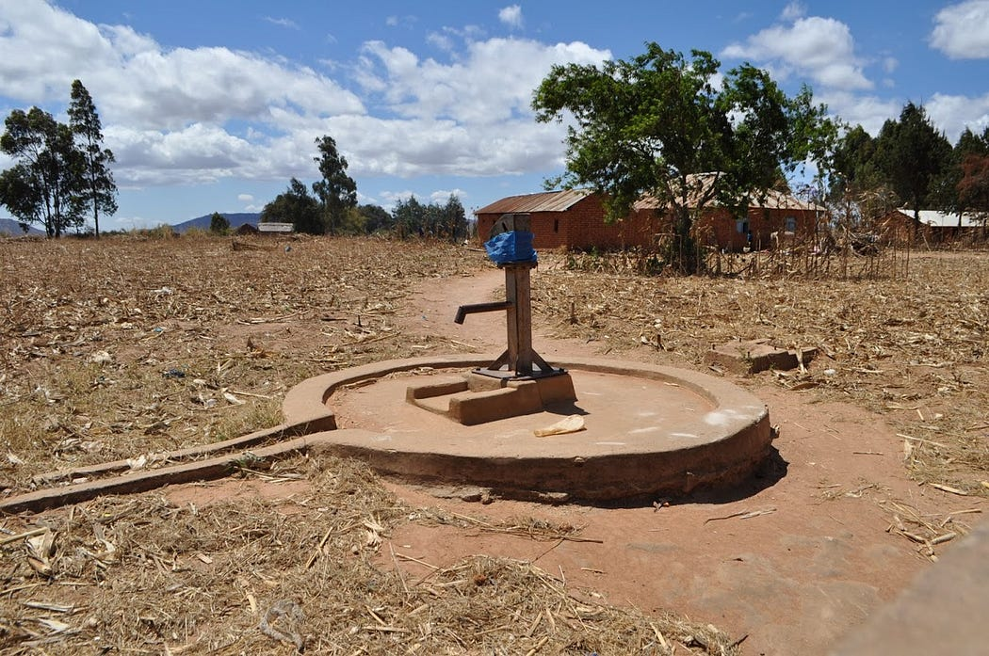
Project Overview
Tanzania is facing challenges with its water supply, particularly maintaining the functionality of existing water wells.
Goal : Our goal is to help predict the condition of water wells using various factors such as the type of pump, installation year, and other key attributes. This can assist NGOs and the Tanzanian government in making data-driven decisions about well repairs and planning.

Slide 3
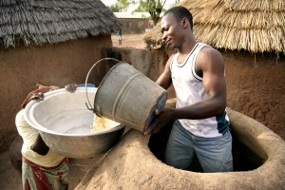
Problem Statement
Challenge: Many water wells across Tanzania are not functioning as they should. This leads to issues with access to clean water, especially in rural areas.
Solution: We built a model that predicts whether a well is functional, functional but needs repair, or non-functional, helping prioritize resources.

Slide 4
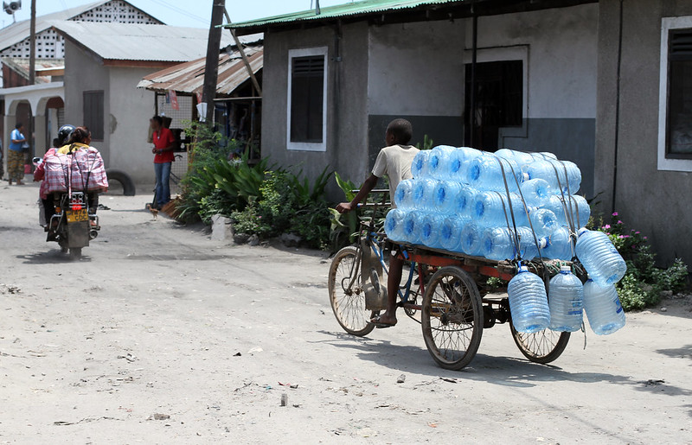
Business Understanding
Relevance : Water is essential for health, agriculture, and daily life. Efficiently managing the water infrastructure is critical for improving access to clean water.
Target Audience: NGOs, Government bodies, and policymakers can use this information to plan repairs, allocate resources, and strategize new well installations.

Slide 5
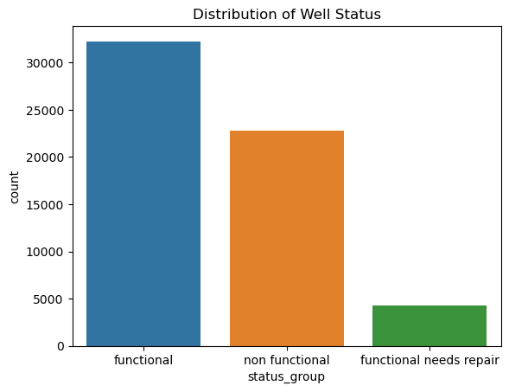
Data Understanding
54%
N = 59,400
38%
8%
Data source : https://taarifa.org/

Slide 6
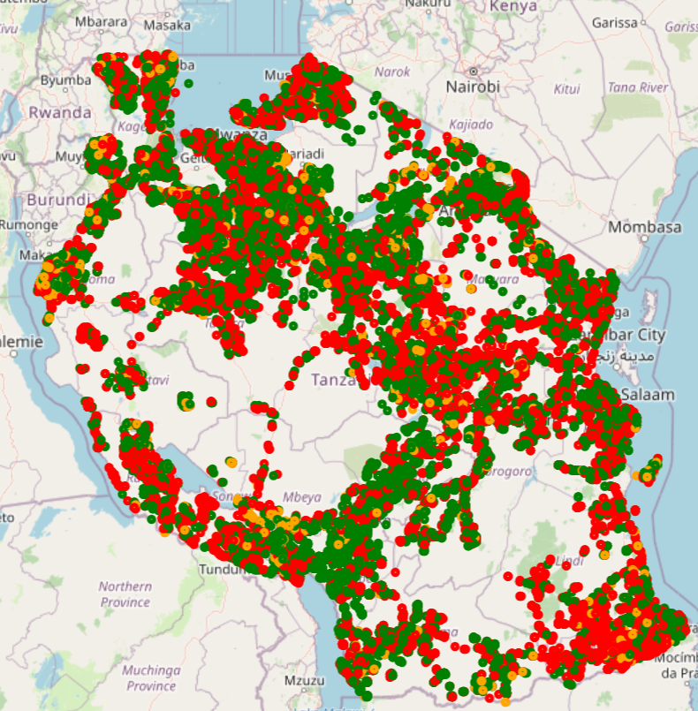
Data Visualization
A map of Tanzania shows where wells are located and their current status.

Slide 7
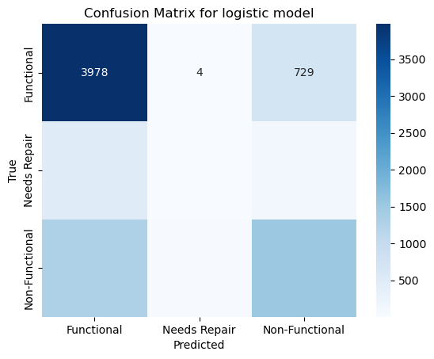
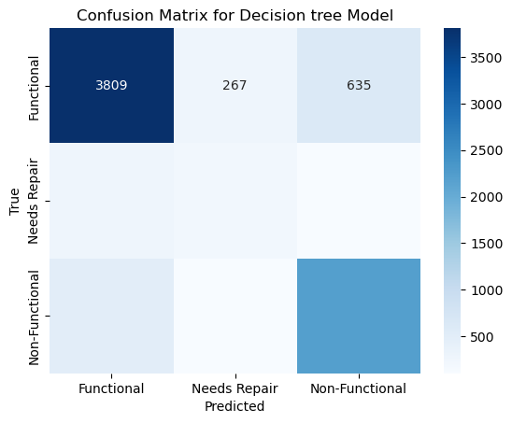
Model Selection
Logistic Model
Decision Tree
Model accuracy : 67%
Model accuracy : 77%
Precision – 0.6413
Recall – 0.6743
F1 –Score –0.6435
Precision – 0.7672
Recall – 0.7658
F1- Score – 0.7663

Slide 8
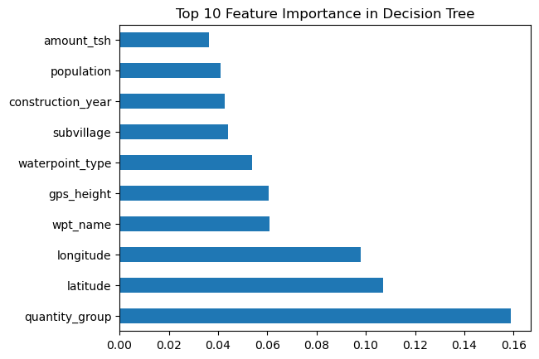
Feature importance in Decision Tree

Slide 9
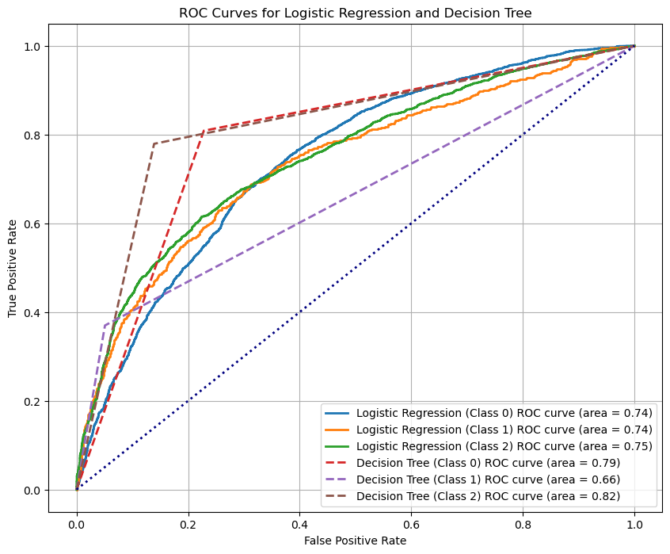
Evaluating Model Performance with ROC Curves

Slide 10
Limitations
The data might be imbalanced, which could affect the performance of the classifier.
Missing values were imputed, which might have introduced bias into the model.
Some important features are missing, such as real-time sensor data or seasonal information.

Slide 11
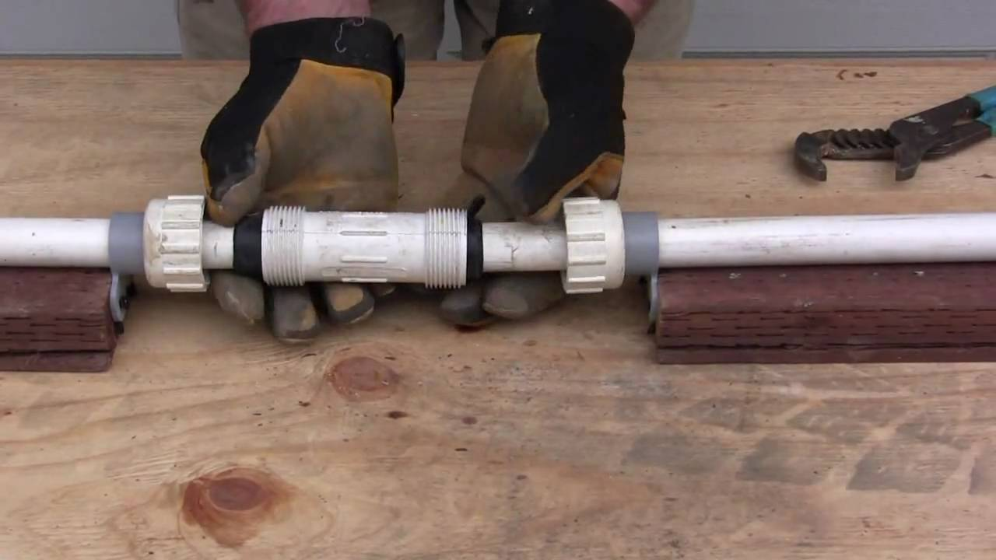
Recommendations
Prioritize Non-Functional Wells for Maintenance and Repair
Further Investigate Wells Needing Repair
Implement Predictive Maintenance Programs
Long-Term Policy Planning

Slide 12
Thank YOU!
Any Question?

